Slide 1


Course: Data Structure​
(Course Code: ETCCDS202 )​
UNIT-1: Foundations of Data Structures​
Dr. Shahjad, Mr. Deepak, Neetu Ma’am​
School of Engineering & Technology
K.R. Mangalam University
Notes:
New Courses replaced with New Programmes

Slide 2

SESSION 8:
Recursion: Concept & Call Stack
Notes:
New Courses replaced with New Programmes

Slide 3
Quick Recall
What does it mean to make a locally optimal choice?
Does every problem solved using a Greedy approach give the best overall solution?
Why do we store previously computed results in programming?
What happens if the same subproblem is solved again and again?
Notes:
New Courses replaced with New Programmes

Slide 4
Connecting Old to New
We already studied:
Divide & Conquer (breaking problems)
Recursion (function calls itself)
Today’s recall focus:
Greedy → decision-based approach (no backtracking)
Dynamic Programming → memory-based approach (reuse results).
Notes:
New Courses replaced with New Programmes

Slide 5
One-Line Recall Summary
Greedy: Choose best option now, do not reconsider
Dynamic Programming: Solve once, store, and reuse
Key Difference: Speed vs Optimality
Notes:
New Courses replaced with New Programmes

Slide 6
Learning Objectives
After this lecture, students will be able to:
Explain the concept of recursion
Identify base and recursive cases
Understand how the call stack works
Trace recursive function execution
Compare recursion with iteration
Notes:
New Courses replaced with New Programmes

Slide 7
– What is Recursion?
Simple Definition Recursion is a technique where: A function calls itself
To solve a smaller version of the same problem
Key idea: Solve big problem using smaller problems
Notes:
New Courses replaced with New Programmes

Slide 8
Two Essential Parts of Recursion
Every recursive function must have:
Base Case – stops recursion
Recursive Case – function calls itself
Notes:
New Courses replaced with New Programmes

Slide 9
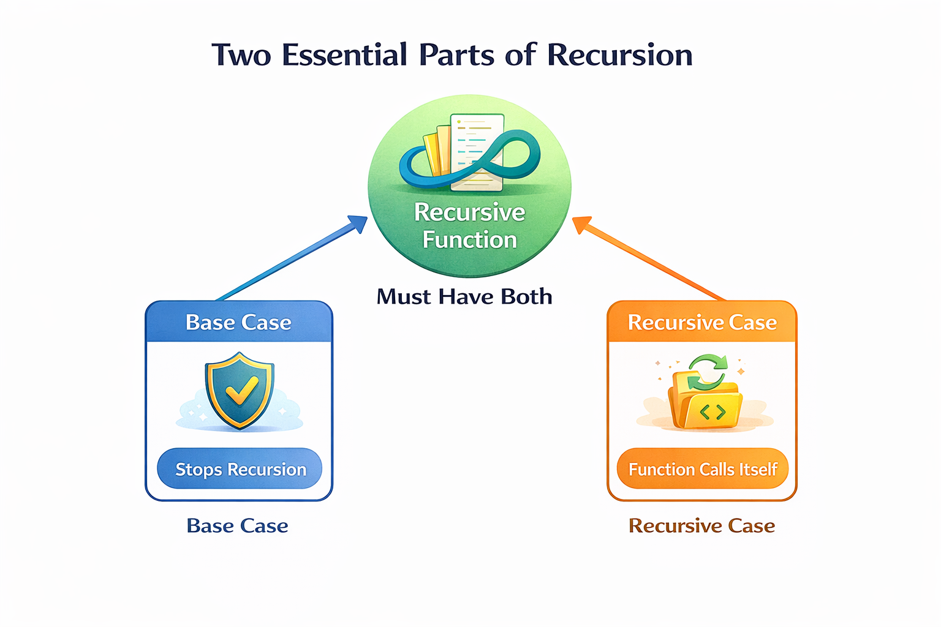
Two Essential Parts of Recursion
Notes:
New Courses replaced with New Programmes

Slide 10
Steps to Implement Recursion
Step1 - Define a base case: Identify the simplest (or base) case for which the solution is known or trivial.
Step2 - Define a recursive case: Define the problem in terms of smaller subproblems. Break the problem down into smaller versions of itself, and call the function recursively to solve each subproblem.
Step3 - Ensure the recursion terminates: Make sure that the recursive function eventually reaches the base case, and does not enter an infinite loop.
Step4 - Combine the solutions: Combine the solutions of the subproblems to solve the original problem.
Notes:
New Courses replaced with New Programmes

Slide 11
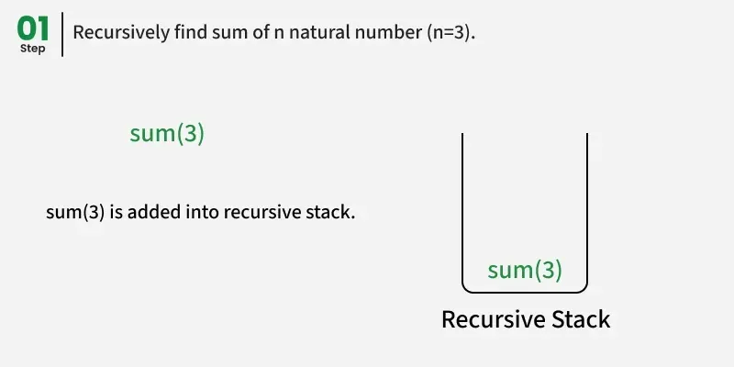
Example: To Sum N=3
Execution Flow of the Recursive Solution
Execution Flow of the Recursive Solution
Calls are stacked as sum(3) → sum(2) → sum(1) before any addition happens. Results are added back in reverse: sum(1) = 1, sum(2) = 3, sum(3) = 6.
Notes:
New Courses replaced with New Programmes

Slide 12
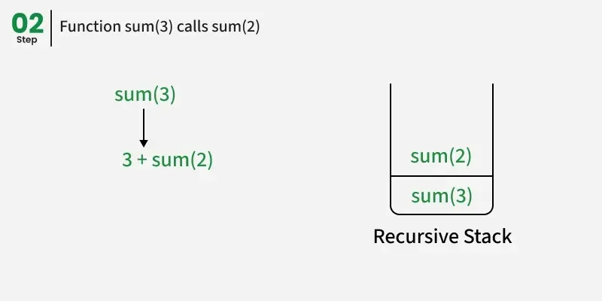
Example: To Sum N=3..
Notes:
New Courses replaced with New Programmes

Slide 13
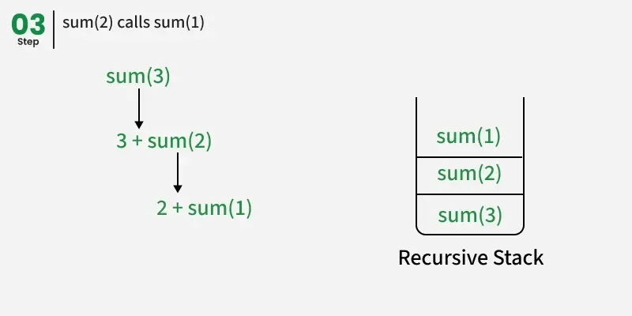
Example: To Sum N=3..
Notes:
New Courses replaced with New Programmes

Slide 14
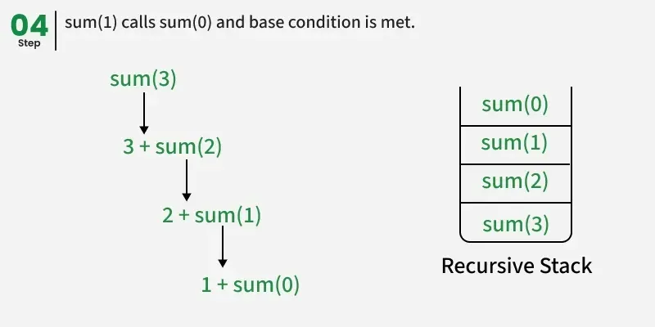
Example: To Sum N=3..
Notes:
New Courses replaced with New Programmes

Slide 15
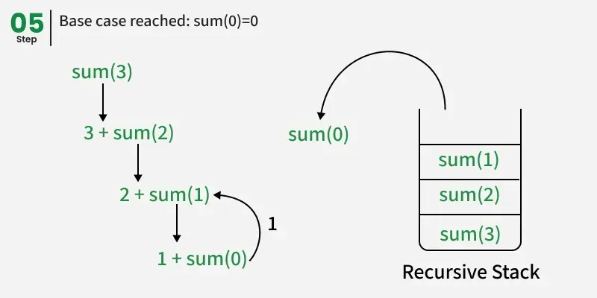
Example: To Sum N=3..
Notes:
New Courses replaced with New Programmes

Slide 16
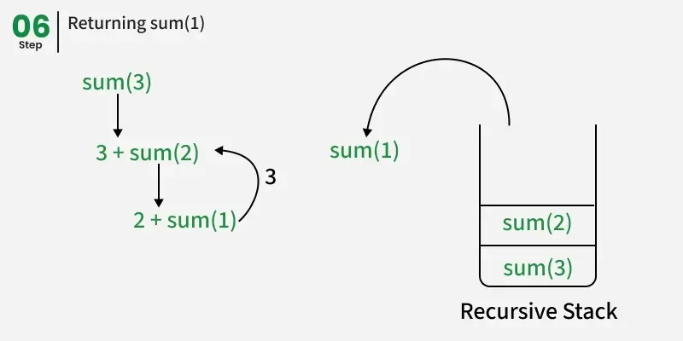
Example: To Sum N=3..
Notes:
New Courses replaced with New Programmes

Slide 17
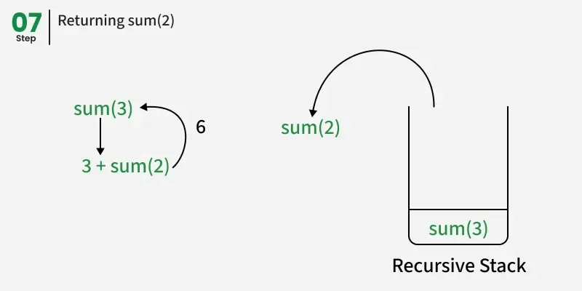
Example: To Sum N=3..
Notes:
New Courses replaced with New Programmes

Slide 18
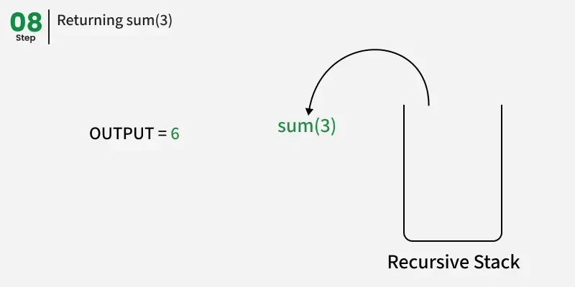
Example: To Sum N=3..
Notes:
New Courses replaced with New Programmes

Slide 19
Real-Life Analogy
Example: Looking into Mirrors
Mirror reflects another mirror
Continues until reflection ends
Similar to recursion stopping at base case
Concrete analogy improves understanding
Notes:
New Courses replaced with New Programmes

Slide 20
Stack
What is a Call Stack?
Simple Explanation: Call Stack is:
A memory structure
That stores information about active function calls
Works on LIFO (Last In, First Out) principle
Key idea: “Last called function finishes first”

Slide 21
Call Stack Visualization
Flow of Recursive Calls
main() → factorial(3)
factorial(3) → factorial(2)
factorial(2) → factorial(1)
Use stack diagram (push & pop)

Slide 22
Worked Example (Stack Trace)
Tracing factorial(3)
factorial(3) pushed
factorial(2) pushed
factorial(1) pushed
Stack starts popping
Step-by-step modeling (Rosenshine)

Slide 23
Common Errors in Recursion
❌ Missing base case ❌ Infinite recursion ❌ Stack overflow error
Misconceptions highlighted and corrected early

Slide 24
Recursion vs Iteration
Aspect | Recursion | Iteration
Code | Simple | Longer
Memory | More | Less
Stack Use | Yes | No
Speed | Slower | Faster

Slide 25
Class Activity
Identify base & recursive case
Trace recursive calls for factorial(4)

Slide 26
Recursion: Concept & Call Stack – Questions
Define recursion in your own words and give a simple example.
Explain the difference between direct recursion and indirect recursion.
What is a base case in recursion, and why is it important?
What happens if a recursive function does not have a base case?
Explain the concept of recursive depth with an example.

Slide 27
Reflection, Practice & Homework
Reflection
Why is base case important?
When should recursion be avoided?
Homework
Write recursive logic for Fibonacci
Convert recursive solution to loop

Slide 28
THANK YOU

